Slide 1
NEXT GEN REPORTING: Extend Reports with Data-Driven Notifications
Jon Stjernegaard Vöge

Slide 2
Jon Stjernegaard vöge
professional
Senior Consultant at Inspari – a valantic company, driving Power Platform projects and internal community/knowledge center
Education
MSc. Business Administration & E-Business from Copenhagen Business School
Passion
Empowering business users to work better with data, making better decisions, and take matter into their own hands.
personal
28 years old, hobby cyclist, puzzle enthusiast and board game nerd

Slide 3
agenda
SETTING THE STAGE
Pause and think – Does this need to be a report/dashboard?
SOLUTION WALKTHROUGH
How to set up data driven notifications with:
Power BI (Dynamic) Subscriptions
Power BI Metrics
Power Automate
Data Activator
SOLUTION COMPARISON
Pros & Cons comparison of all the solutions.
WRAP UP
Main takeaways – What should you do?

Slide 4
DOES all insight HAVE TO BE SERVED IN A REPORT?

Slide 5




Solution Walkthroughs
Subscriptions
metrics
Data activator
Power automate
Easiest
Hardest

Slide 6
Solution 1: Power BI Subscriptions
Automated subscription of report snapshot
Send recurring snapshot of report as .pdf or .pptx, including link to actual Power BI report. Choose to send full report, or specific pages.
email recipients or save to Onedrive/sharepoint
Customize Email Subject / Message, or save snapshots with timestamp to a folder in OneDrive/Sharepoint.
Flexible Scheduling Options
Repeat on a logical schedule (hourly, daily, weekly, monthly) at a specific time, or schedule to send upon model refresh.

Slide 7
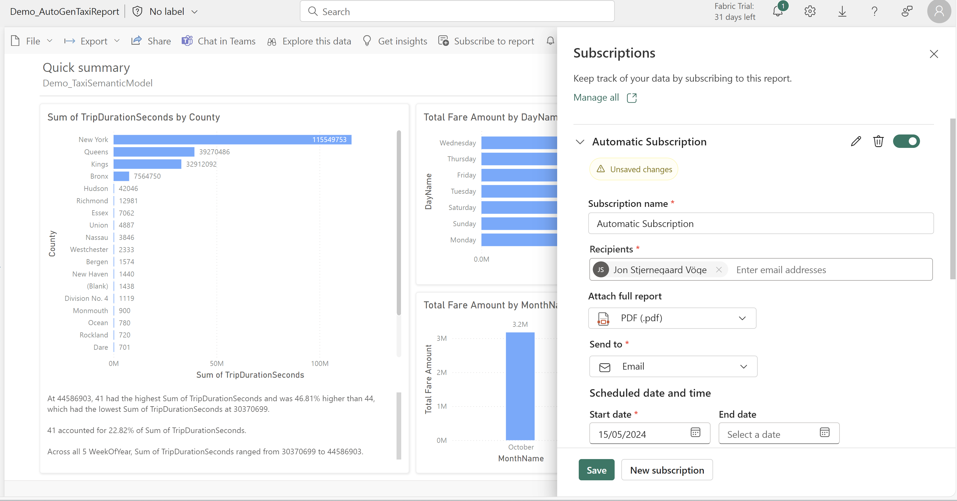

Slide 8

Solution 1b: Power BI dynamic Subscriptions
Dynamic version of classic subscriptions
By including a table of recipients in your data model, you can dynamically alter both the list of recipients as well as the content for each recipient.
Filter data in snapshots based on users
Classic subscriptions are limited to sending Full Reports/Report Pages. Dynamic subscriptions can filter each page, based on what each user should see (imilar to RLS)
Parameterized Pages and Attachments
You may even use information from your datamodel to alter which filetype each recipient should receive their snapshot in.

Slide 9
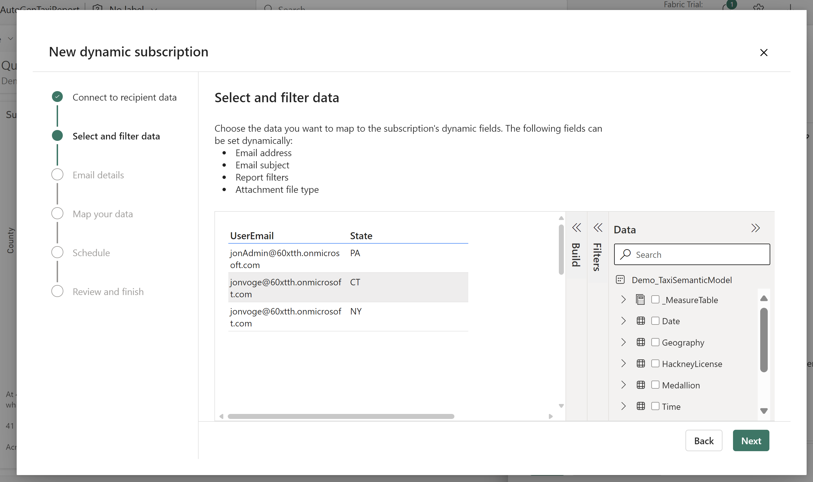
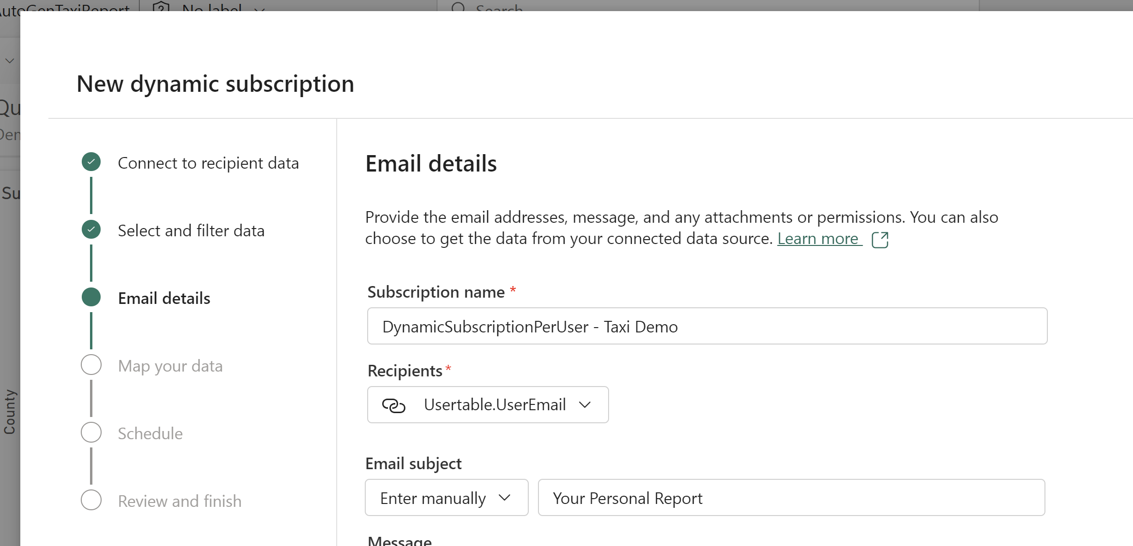
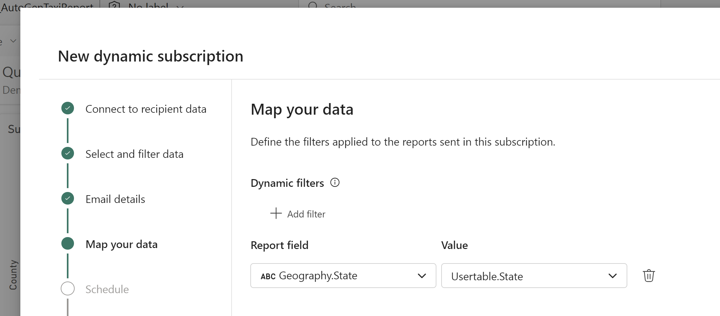

Slide 10
Solution 2: Power BI Metrics (AKA Scorecards)
Create metrics based on power bi visuals
Choose a value in a report to monitor, and set up manual or data driven status rules, to change the status of your metrics.
Follow metrics to receive notifications
Following a metric creates automated Teams notifications with links to metric and report, when the status of your metrics change.
Collaborate on metrics with your team
Add qualitative input via check-ins on metrics, assign metrics to team members, and group metrics together in aggregate metrics.

Slide 11
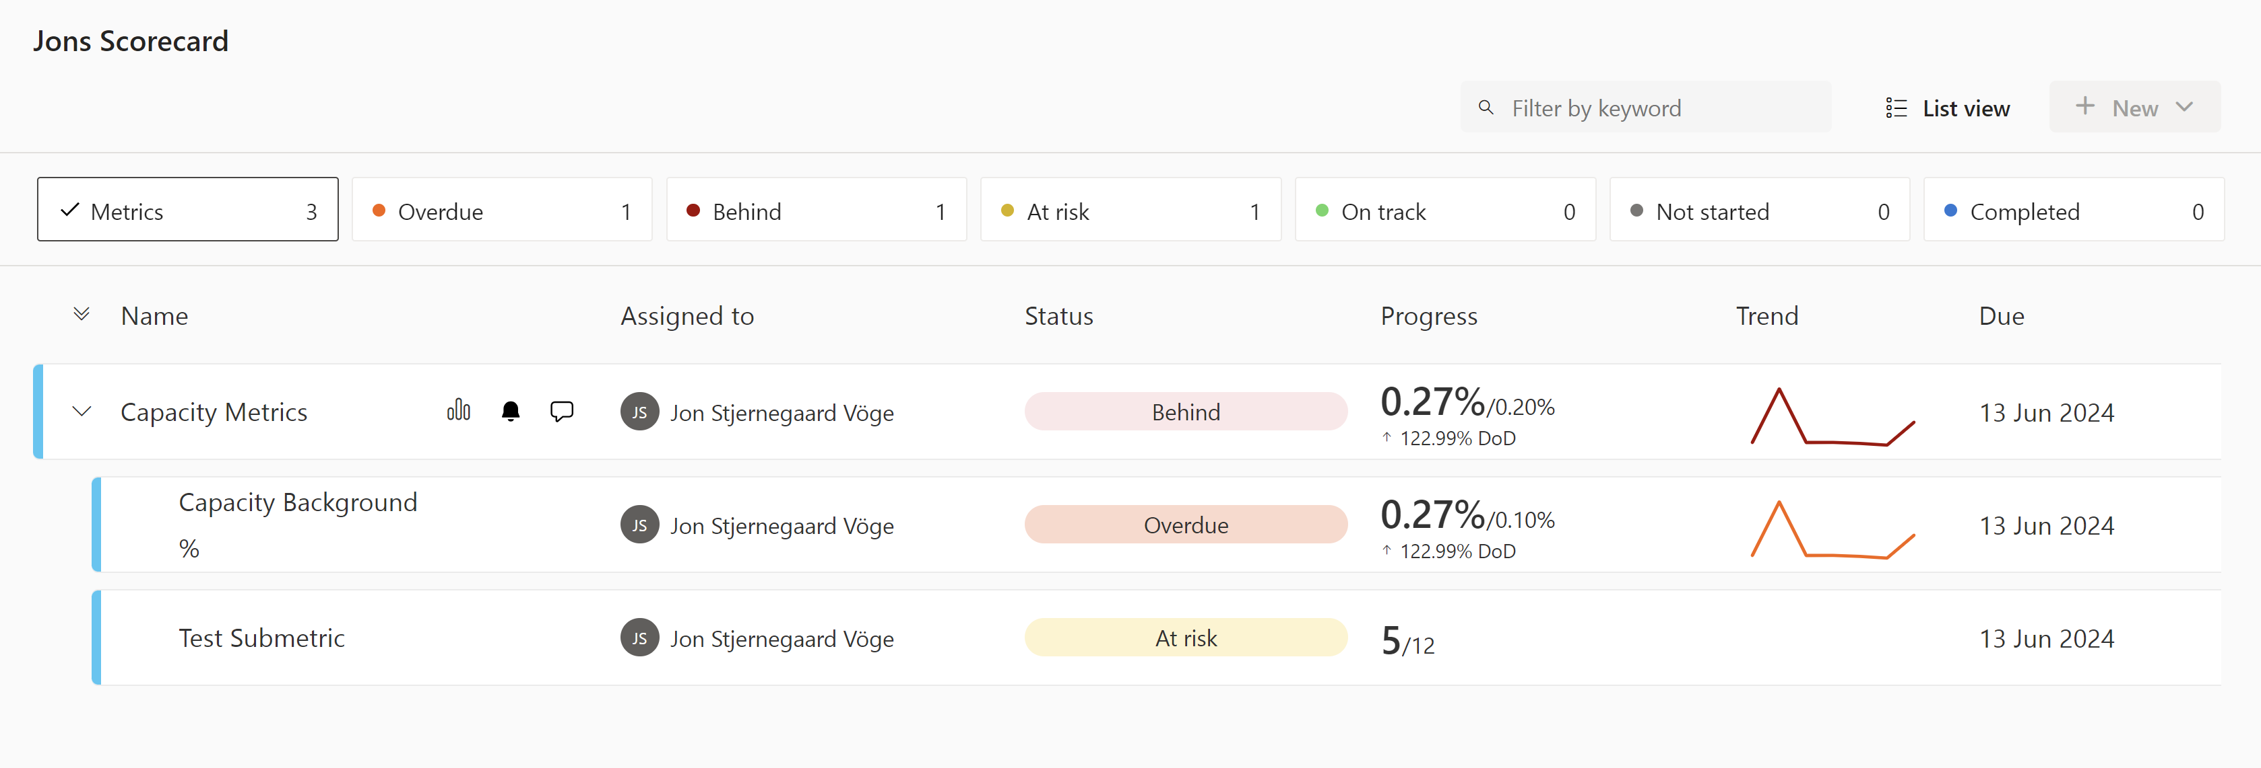
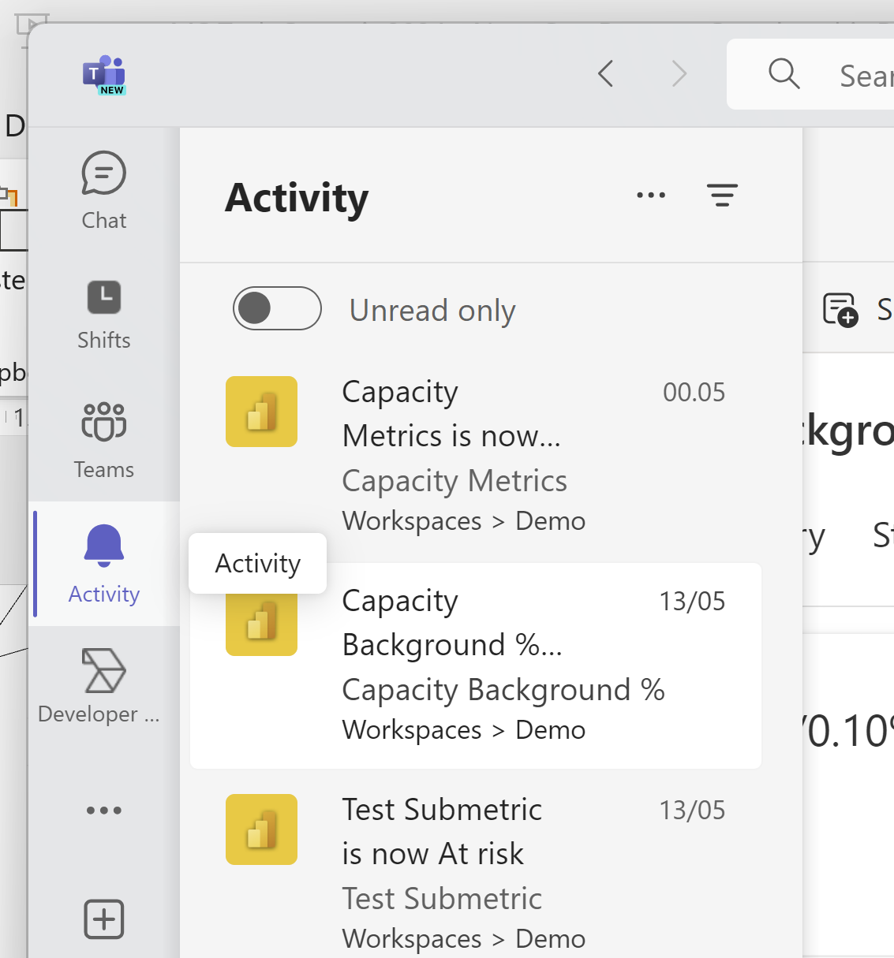
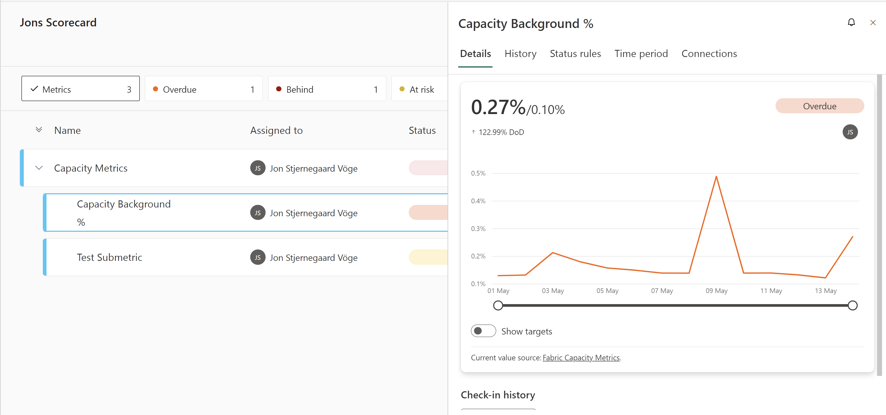

Slide 12
Solution 3: Data activator
Listen on eventstreams or (most) power bi visuals
Data Activator uses Reflexes to monitor incoming data streams. Eventstreams are evaluated every minute, while Power BI visuals every hour.
Create triggers to control notification behaviour
Elaborate trigger controls on the incoming data stream allow you to define very specific behaviour:
A value enters a range, and stays within that range for x minutes
A value exceeds a threshold x number of times in x number of hours
A value increases by x % compared to last measurement/time point
Act on triggers by sending emails/teams messages
Send notifications by Email / Teams which includes link to reflex, as well as any dynamic properties defined.

Slide 13
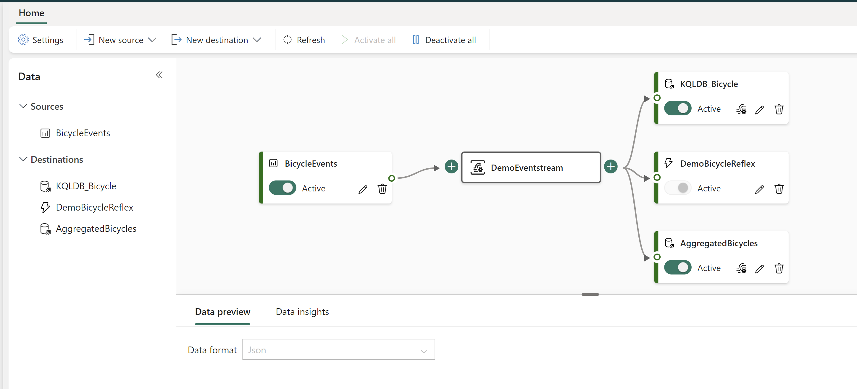
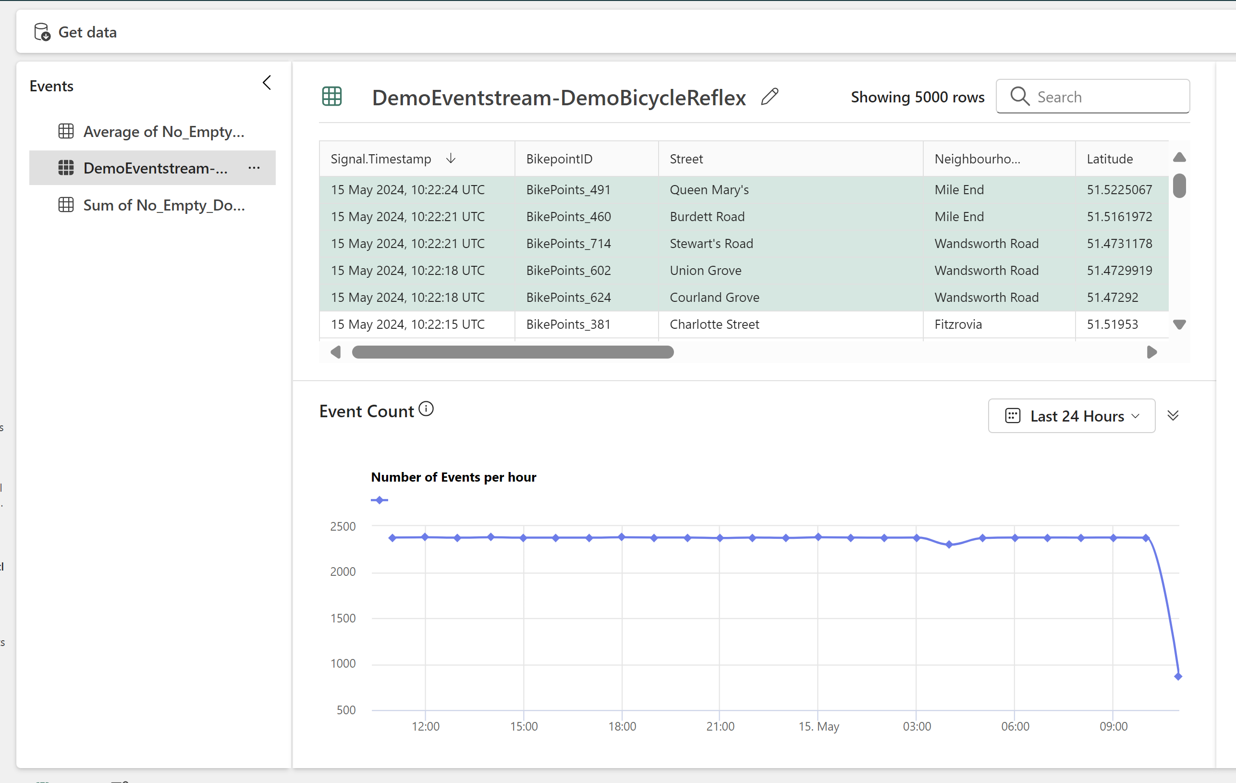

Slide 14
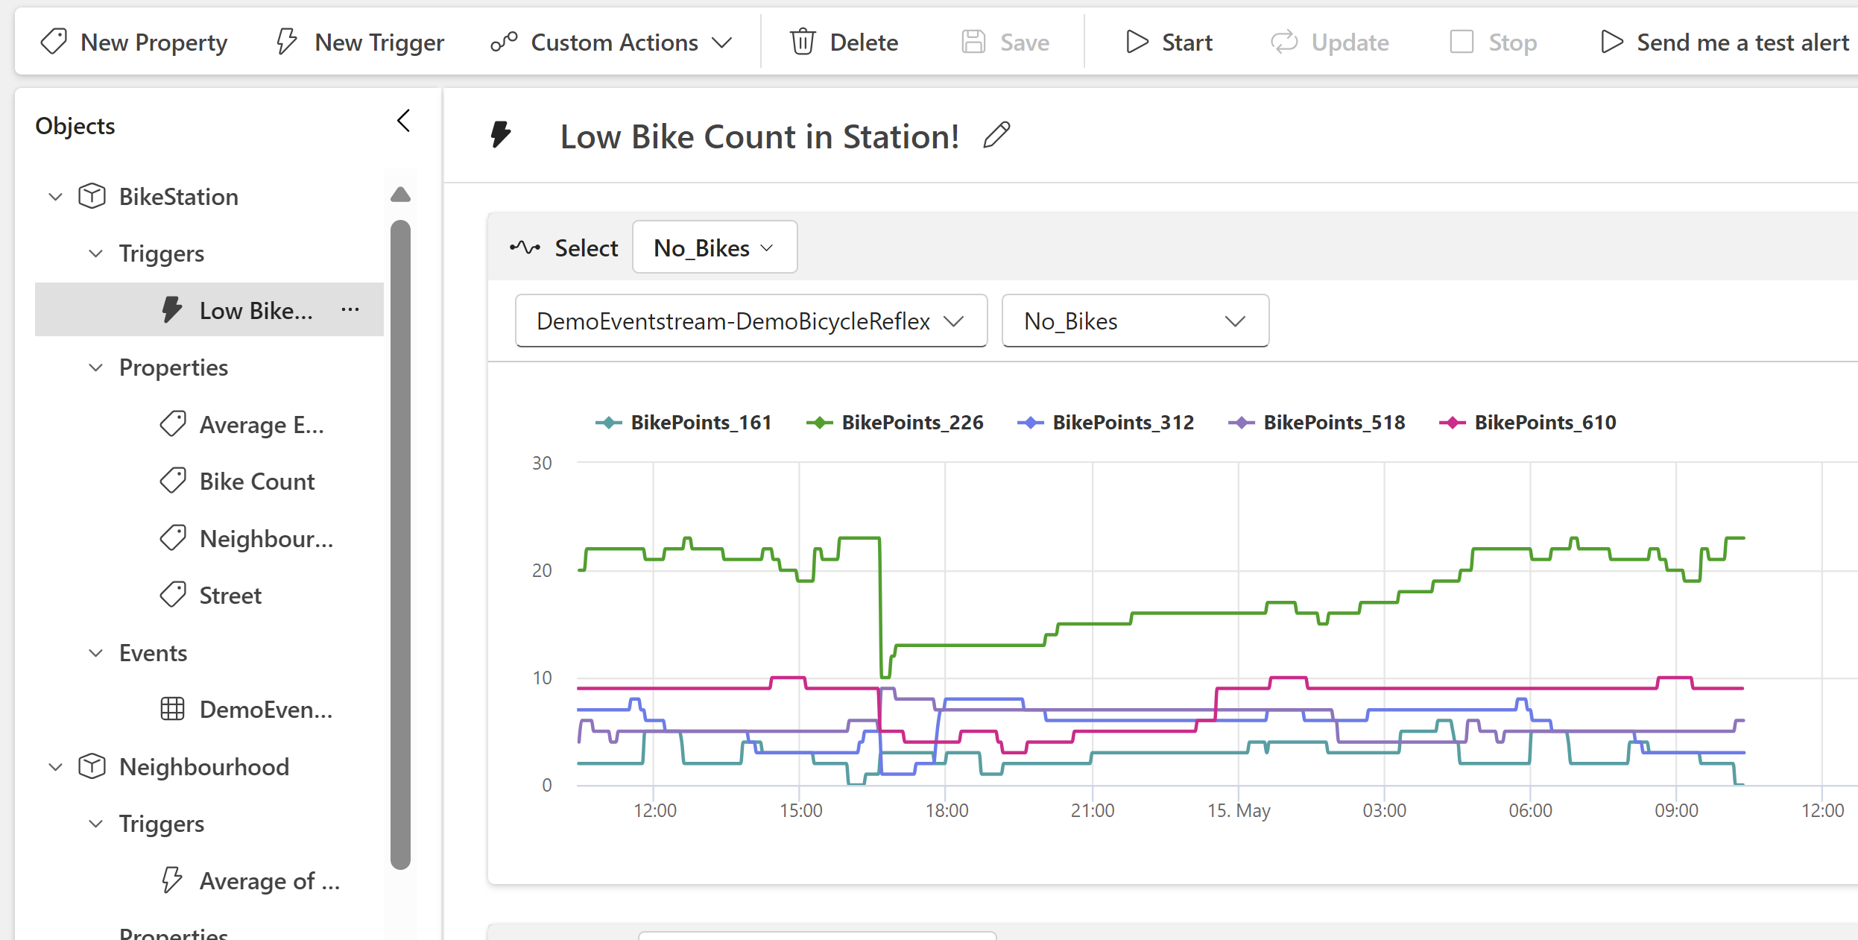
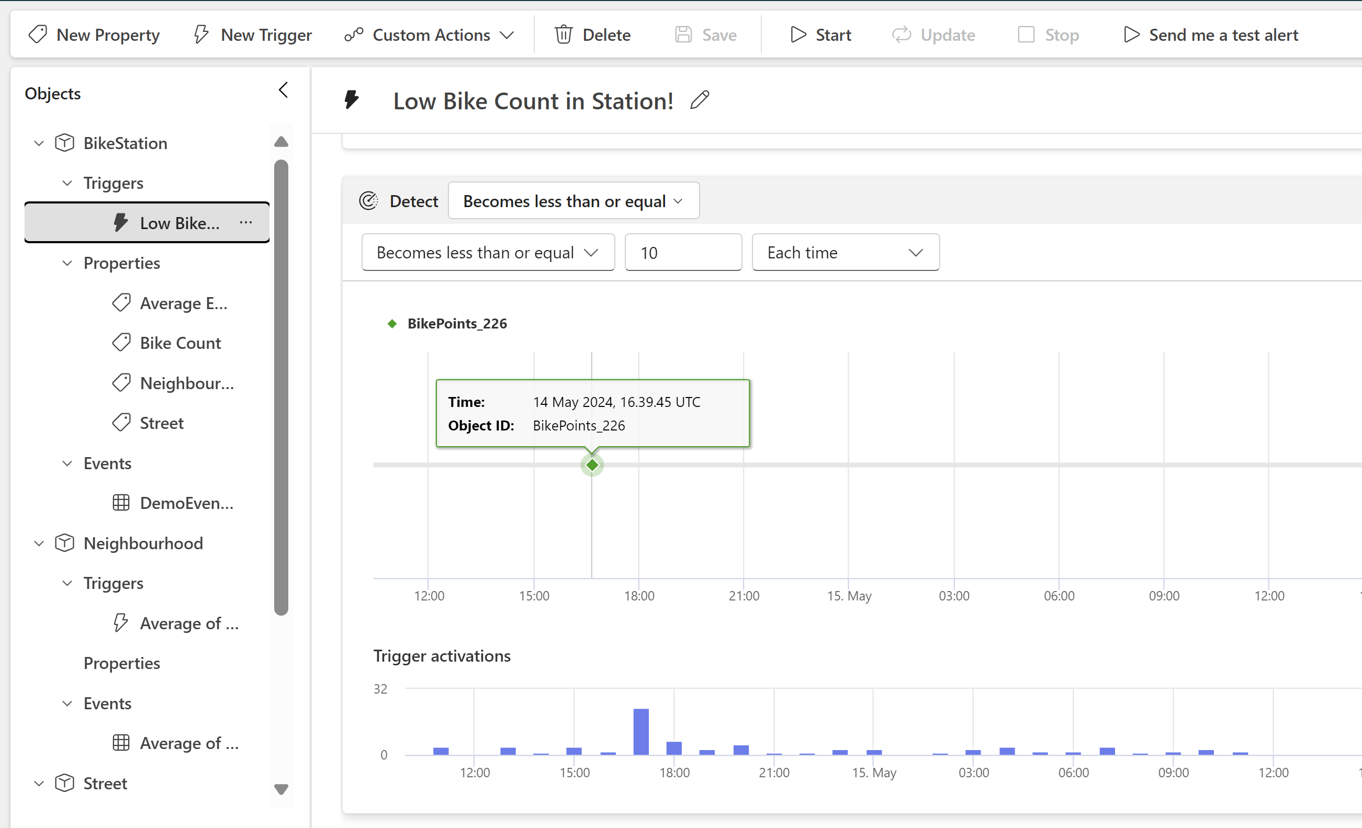
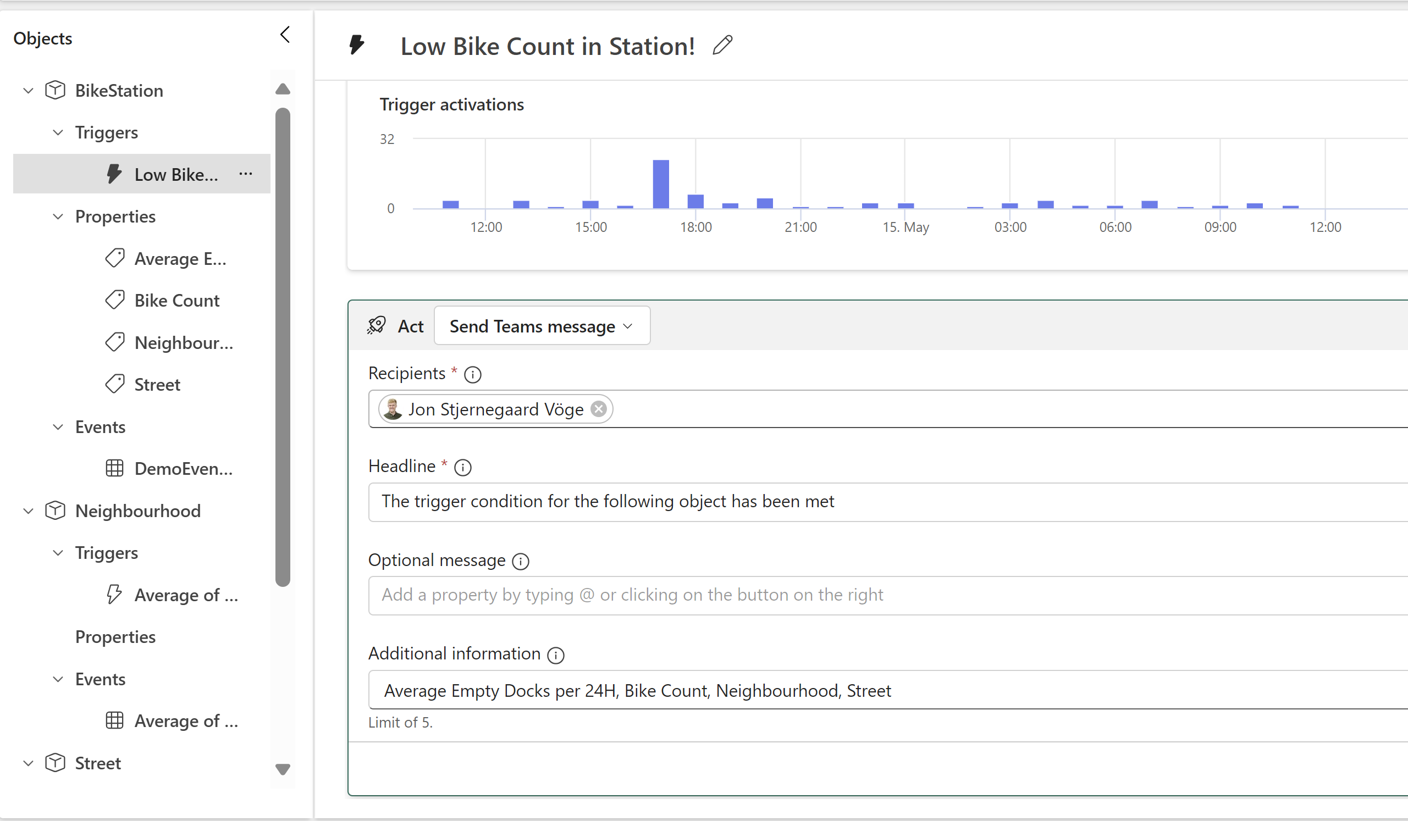
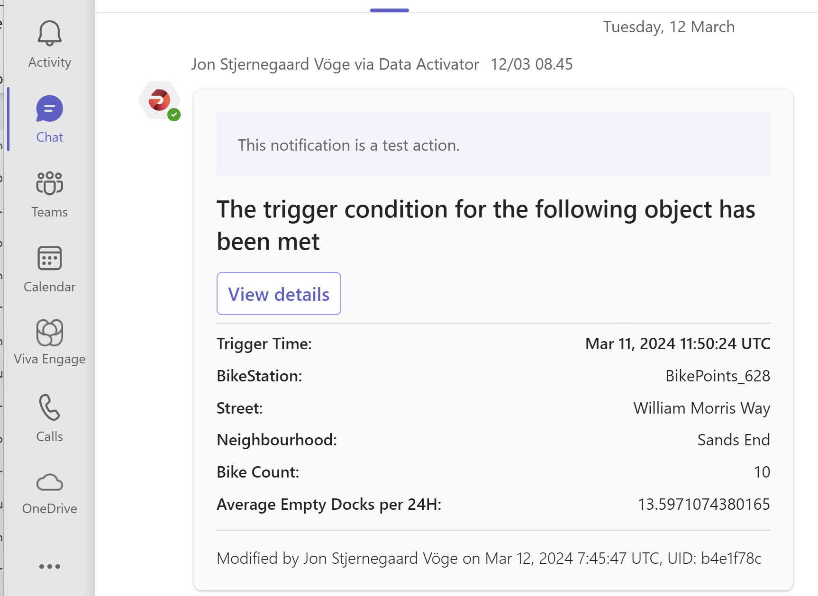

Slide 15
Solution 4: Power automate
Custom actions for Data Activator, Metrics & Subscriptions
Power Automate integrates with all the previously mentioned tools to provide completely custom notification solutions based on the triggers.
Imagination is the boundary
While the other tools natively just supports Email & Teams notifications, Power Automate can send messages to Slack, SMS, create Jira tickets, or anything else you can imagine.
Query directly on Semantic Models
In addition, Power Automate lets us query Semantic Models directly, allowing us to create very specific alerts based on DAX.

Slide 16
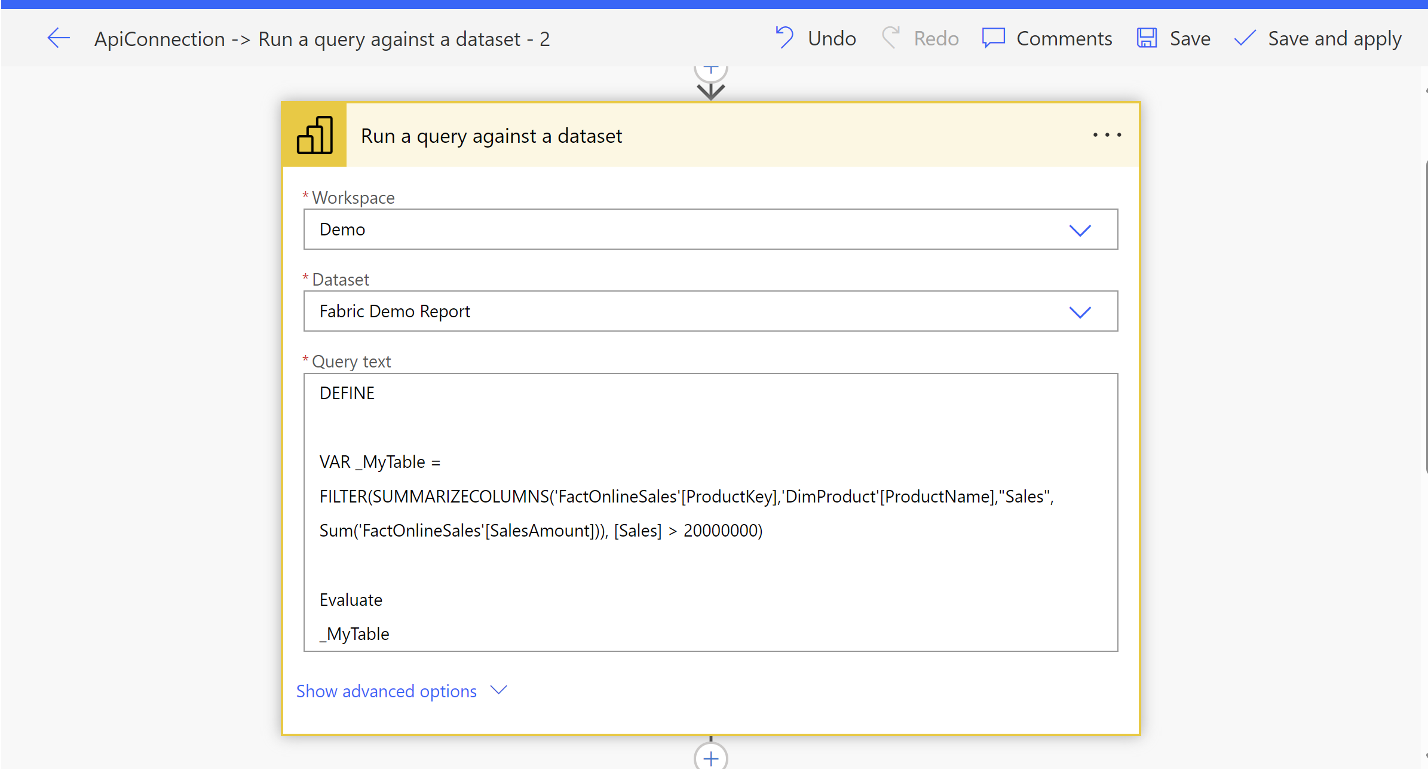
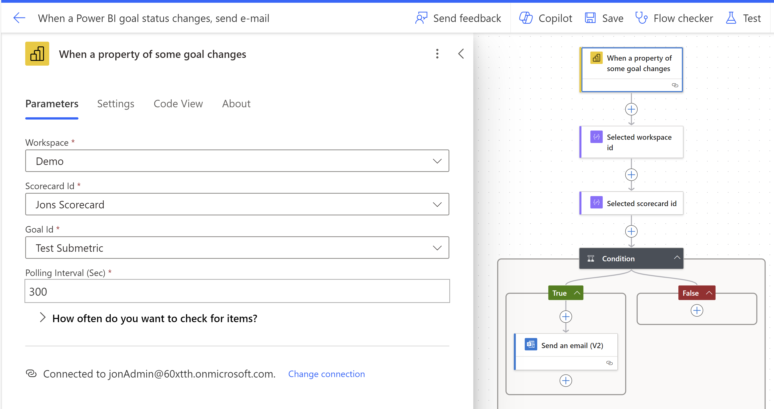
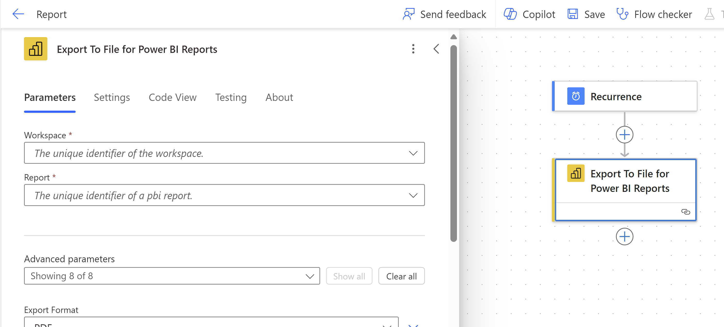

Slide 17
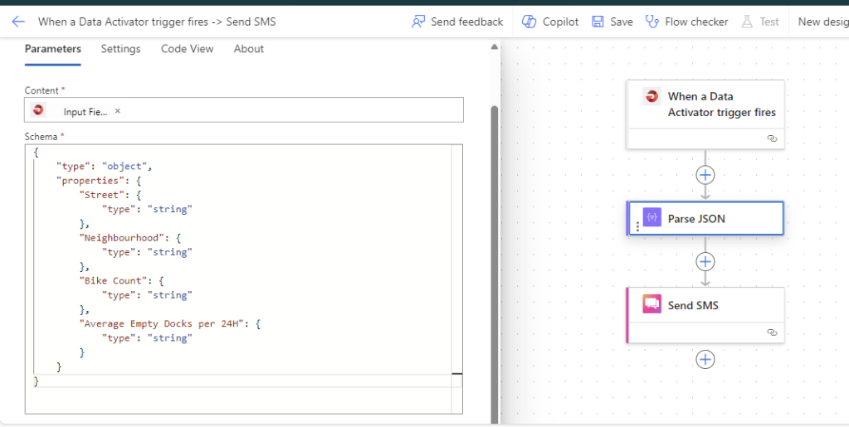
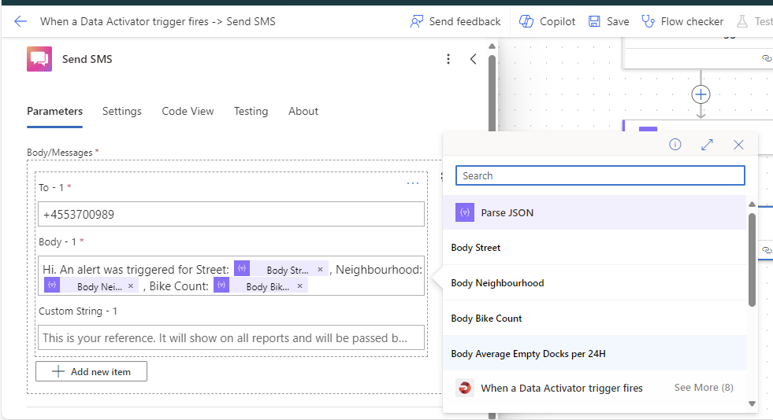

Slide 18
PROS
Easy and fast setup
Easy Dynamic Recipients – may use existing RLS model.
Only requires Power BI
Monitor Power BI visuals
Easy goal and status change tracking
Easy to get started with notifications
Listen on Eventstreams and Power BI visuals
Easy but comprehensive trigger setup
Extremely Customizable
Enhances functionality of other tools

Slide 19
CONS
Only available on schedule.
Limited to Email/Sharepoint/Onedrive delivery
Not very customizable in terms of email content.
Can’t listen on data model – requires a Power BI visual.
Not very customizable in terms of notification content.
Requires Fabric
Power BI triggers limited to hourly checks.
Notifications only somewhat customizable
Requires Power Automate
Can be complex to configure, depending on use case.

Slide 20
WHAT SHOULD YOU CHOOSE?
Pre-reqs
Power BI | Power BI | Fabric | Power Automate
Easy, scheduled snapshots of reports | Easy notifications on Power BI visuals on model refresh | Best compromise between ease-of-use and timeliness | Complex trigger and action requirements.
Use case

Slide 21
Questions?

